Slide 1
A project to develop geospatial thinking learning lines in secondary schools
GI-Learner
Luc Zwartjes
luc.zwartjes@ugent.be

Slide 2
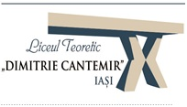
GI-Learner partners

Slide 3
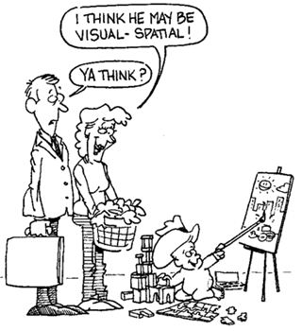
GI Science ← Spatial Thinking
Key Literature
Literature Review
Spatial Thinking dimensions and related terms (Michel & Hof, 2013)
Michel, E. & Hof, A., 2013, Promoting Spatial Thinking and Learning with Mobile Field Trips and eGeo-Riddles, Jekel, T., Car, A., Strobl, J., Griesebner, G. (eds.), GI_Forum 2013: Creating the GISociety, 378-387. Berlin, Wichmann Verlag
Notes:
enables knowing about
- Space – e.g. different ways of calculating distance, coordinate system
- Representation – e.g. effect of projections, principles of graphic design (semiology)
- Reasoning – e.g. different ways of thinking about shortest distances, estimate the slope of a hill fom a map of contour lines

Slide 4
Linking geospatial thinking to GIS
Literature Review
a new geotechnological paradigm (Kerski, 2015)
defined as a new way of doing science
derived from technological advances
the huge increase in availability of spatial data (big data, mining data, crowdsourcing etc.)
tools and data available to citizens
awareness of data quality now essential
Kerski, J.J., 2015. Opportunities and Challenges in Using Geospatial Technologies for Education. In Geospatial Technologies and Geography Education in a Changing World (pp.183-194). Springer Japan.

Slide 5
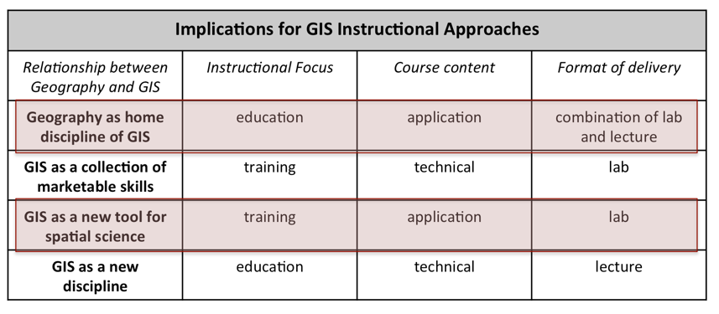
How to implement this?
Literature Review
Four schools of thought on the relationship between Geography & GIS (Sui, 1995)
Sui, D.Z., 1995. A pedagogic framework to link GIS to the intellectual core of geography. Journal of Geography, 94(6), pp.578-591.
Notes:
Two of the four schools describe the ideal vision for secondary education:
The first schools stating that Geography is uniquely suited as the home discipline of GIS. It simply automates the tasks geographers have been doing for several thousands of years, and aims at a full integration of GIS into all aspects of geography curriculum.
The third school seeing GIS as the tool to support scientific inquiry as ultimate goal in a variety of disciplines, thus GIS as enabling tool for science.
Both put the emphasis of the course content on application – GIS as a tool, whereas the two other schools are focusing on the technical aspects of GIS.

Slide 6
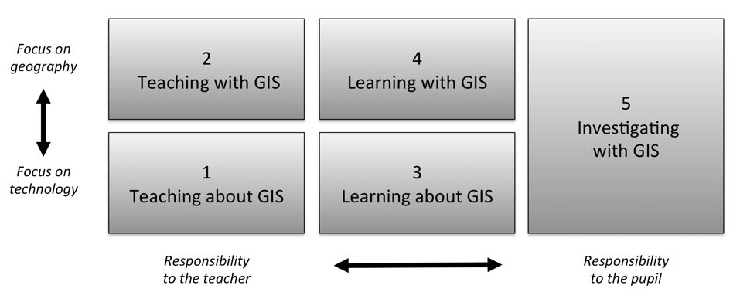
How to implement this?
Literature Review
Five ways of integrating GIS in geography education (Favier, 2013)
Favier, T.M., 2011, Geographic Information Systems in inquiry-based secondary geography education, Vrije Universiteit Amsterdam, 287 pp.
Notes:
Favier (2013) describes five ways on how GIS can be integrated in secondary education (Figure 8). Teaching and learning about GIS focuses more on the theoretical aspects of GIS (knowledge of GIS, structure of the technology), where the three other ways use the technology to develop and use spatial thinking skills

Slide 7
What is still blocking it?
Literature Review
schools in Europe nowadays generally have better ICT equipment
Cloud-based developments
pupils increasingly asked bring their own devices
more openly available data
Web-based platforms have reduced / no costs
networking and communities encouraged and available – social media (digital-earth, eduGIS)

Slide 8
What is still blocking it?
Literature Review
Content already exists …
iGuess → www.iguess.eu
I-Use → www.i-use.eu
EduGIS → www.edugis.nl, www.edugis.pl
PaikkaOppi learning environment → http://www.paikkaoppi.fi/
…but it is not structured or coordinated by age …

Slide 9
Literature Review
What is still blocking it?
GIS is not a compulsory item in teacher training.
Taught by non-specialists, leading to teachers with limited pedagogical content knowledge, resulting in fewer teachers recognizing the potential opportunities GIS offers to teach geography content and skills, teach more and more geography.
Curriculum not included or impedes adoption to include GIS.
The non-availability of data and easy-to-use software.
Attitudes of teachers It seems difficult to persuade teachers to use new technologies, if they are highly demanding technically and if teachers are not fully convinced of the effectiveness and added value.
Bednarz and van der Schee (2006)
Bednarz, S.W. and Schee, J.V.D., 2006. Europe and the United States: The implementation of geographic information systems in secondary education in two contexts. Technology, Pedagogy and Education, 15(2), pp.191-205.

Slide 10
Literature Review
What is still blocking it?
GIS is not a compulsory item in teacher training.
Taught by non-specialists, leading to teachers with limited pedagogical content knowledge, resulting in fewer teachers recognizing the potential opportunities GIS offers to teach geography content and skills, teach more and more geography.
Curriculum not included or impedes adoption to include GIS.
The non-availability of data and easy-to-use software.
Attitudes of teachers It seems difficult to persuade teachers to use new technologies, if they are highly demanding technically and if teachers are not fully convinced of the effectiveness and added value.
Bednarz and van der Schee (2006)
Bednarz, S.W. and Schee, J.V.D., 2006. Europe and the United States: The implementation of geographic information systems in secondary education in two contexts. Technology, Pedagogy and Education, 15(2), pp.191-205.

Slide 11
Recommendations for successful introduction and integration
Literature Review
address key issues related to GIS implementation: teacher training, availability of user friendly software, ICT equipment in schools.
use a community of learners approach and
institutionalize GIScience into curricula, making sure that it is aligned with significant general learning goals like graphicacy, critical thinking and citizenship skills.
Bednarz, S. W. & van der Schee, J. 2006. Europe and the United States: the implementation of geographic information systems in secondary education in two contexts, Technology, Pedagogy and Education. 15 (2), 191-205

Slide 12
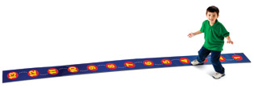
Literature Review
What is a learning line?
A learning line is an educational term that refers to the construction of knowledge and skills throughout the whole curriculum.
This learning line reflects an increasing level of complexity, ranging from easy (more basic skills and knowledge) to difficult.
Zwartjes, L., 2014. The need for a learning line for spatial thinking using GIS in education. Innovative Learning Geography in Europe: New Challenge for the 21st Century, pp.39-62.

Slide 13
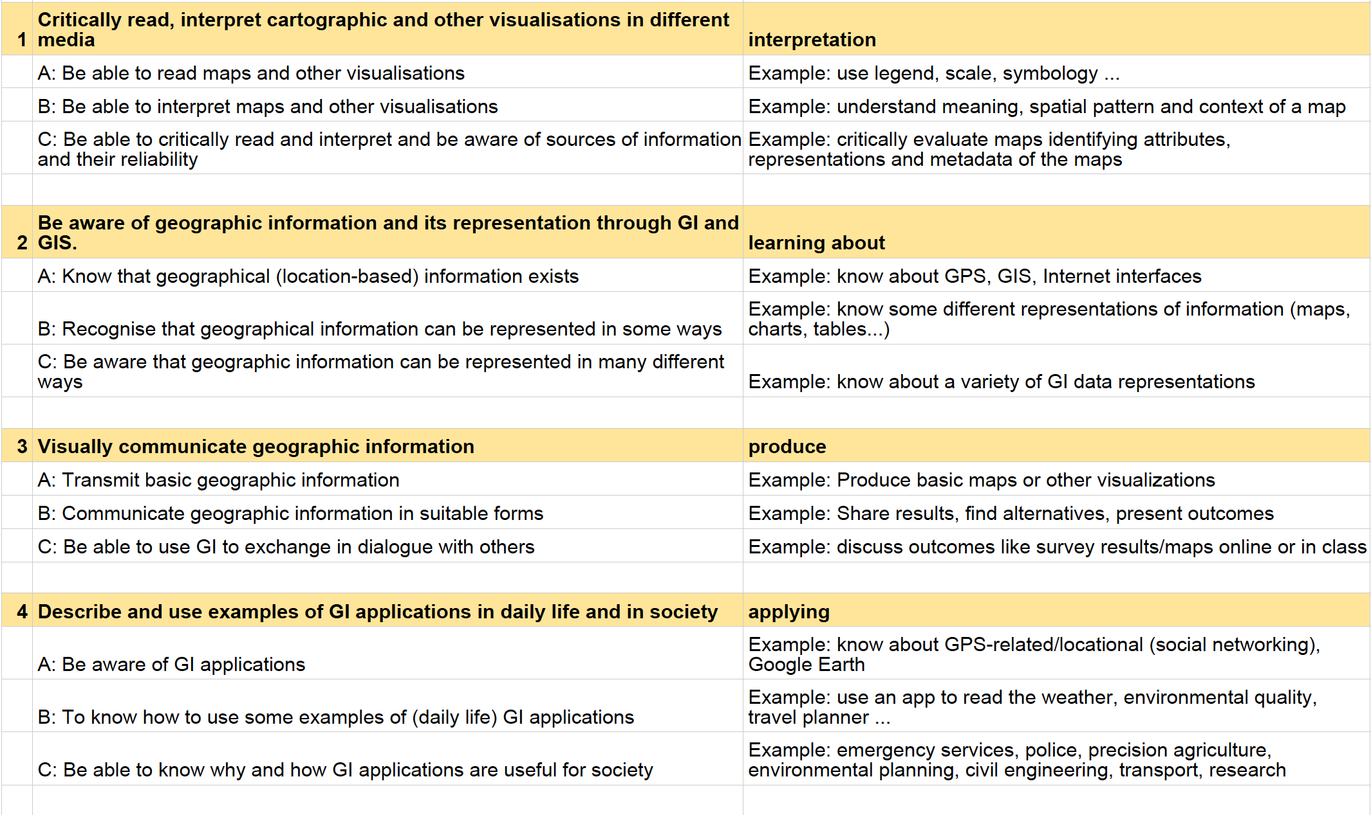
Based on the review, ten geospatial thinking competences are proposed

Slide 14
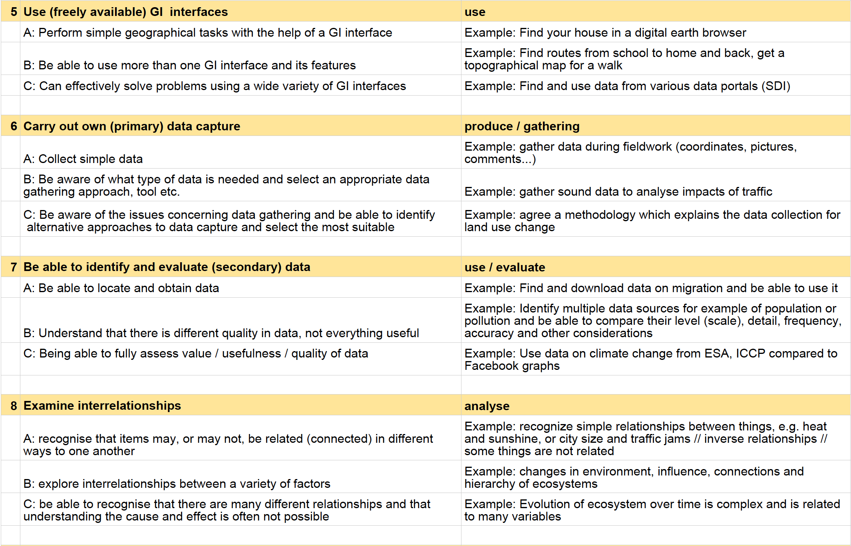
Based on the review, ten geospatial thinking competences are proposed

Slide 15
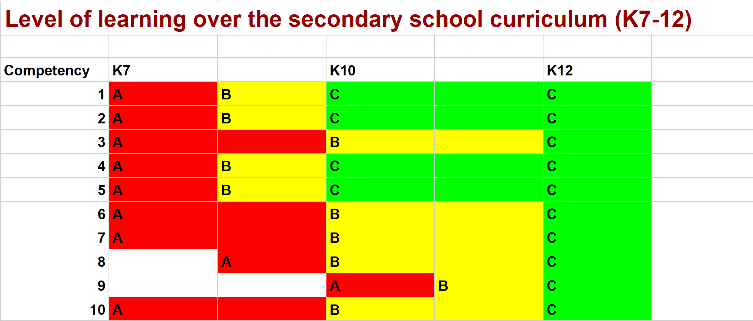
Based on the review, ten geospatial thinking competences are proposed

Slide 16
GI Learner Action Plan
Summarize most important literature on learning lines and spatial thinking - project foundation.
Scan school curricula to identify opportunities to introduce GIScience → used to develop materials.
Create a test to analyse impact of learning lines on spatial thinking
at the start of the project to establish the zero level, baseline value of their spatial thinking capability.
At the end of each year the test will be done, thus measuring the impact of the learning line and to adjust it if needed.

Slide 17
GI Learner Action Plan
Summarize most important literature on learning lines and spatial thinking - project foundation.
Scan school curricula to identify opportunities to introduce GIScience → used to develop materials.
Create a test to analyse impact of learning lines on spatial thinking
at the start of the project to establish the zero level, baseline value of their spatial thinking capability.
At the end of each year the test will be done, thus measuring the impact of the learning line and to adjust it if needed.

Slide 18
GI Learner Action Plan
Summarize most important literature on learning lines and spatial thinking - project foundation.
Scan school curricula to identify opportunities to introduce GIScience → used to develop materials.
Create a test to analyse impact of learning lines on spatial thinking
at the start of the project to establish the zero level, baseline value of their spatial thinking capability.
At the end of each year the test will be done, thus measuring the impact of the learning line and to adjust it if needed.

Slide 19
GI Learner Action Plan
Create first learning lines, translate them into real learning objectives, taking into account curricula opportunities in partner countries
each year one-third of the total learning line will be elaborated (Includes necessary classroom materials)
In Year 1, pupils of different ages (K7 and K10) in partner schools will trial materials, schools give feedback and where appropriate suggest amendments
Final versions of learning outcomes for year 1 lines

Slide 20
GI Learner Action Plan
In year 2, second stage learning lines are developed and used by the pilot groups i.e. in K8, K11
In year 3, third stage learning lines are developed and used by the pilot groups i.e. in K9, K12
Final learning lines are published, with the essential classroom materials, thus facilitating introduction and implementation
A publication with suggestions for inclusion into the national curricula and disseminated among different National Ministries of Education …

Slide 21
GI Learner Evaluation
Two evaluation surveys have been created (for pupils) to self-assess their confidence in the awareness and understanding of the Spatial Thinking competences – Basic – More Advanced

Slide 22
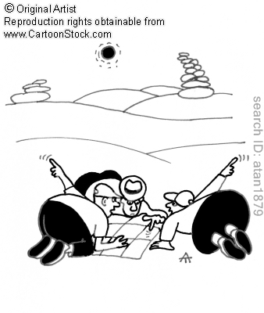
Project Timeframe: September 2015 – August 2018 More info : www.gi-learner.eu Twitter: @GILearner Project coordinator: luc.zwartjes@ugent.be

